Slide 1
Virtualization and Persistence
A 50,000’ view

Slide 2
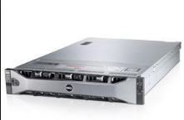
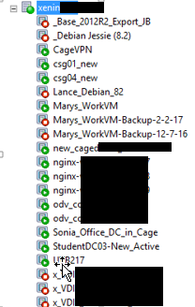
Why virtualization?
One behemoth machine
  One archive (master image)
  Clone quickly, destroy quickly
  Portable for redundancy
Your PC : Run Linux and Windows simultaneously
Here at Toolwire:
  Student Desktops : Destroy and relaunch
  Employee workstations : Virus? Destroy and relaunch

Slide 3
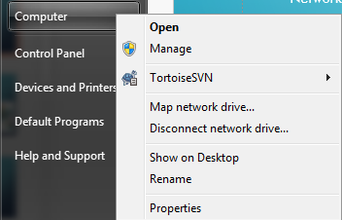
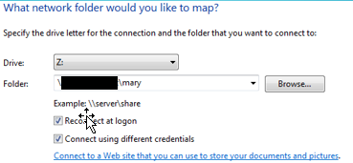
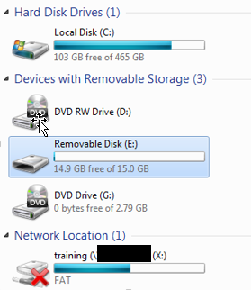
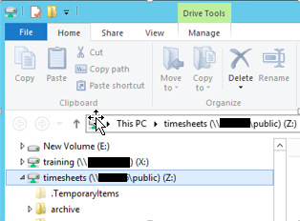
PERSISTENCE
Two forms:
  Network mounts
    My Files U:\ drive
  Removable Storage
    Thumb drive
    External drive
    For VM’s:
      Hotplug Drives
NOTE: C: drive is
NOT persistent!

Slide 4

HOW DOES virtualization WORK?
Imagine the United Nations
  One language speaker
  Many languages communicating with speaker
How can one person understand?
  We need someone who speaks all languages

Slide 5
Virtualized translator : The Hypervisor
Many different O/S … different languages
  Linux/Unix
    ls -al
  Windows
    dir

Slide 6
Hypervisor layer
Unix
Windows
Linux
HYPERVISOR
Xen Server

Slide 7
Xen tools
User Interface to Server
Xen Tools
Xen Server
Just a Linux Server with Citrix installed

Slide 8
HYPERVISOR = TRANSLATOR
Windows Virtual Machine
Manages system resources for virtual machines
  CPU
  Memory (RAM)
  Local Storage
Exposes system resources to virtual machines
Exposes system hardware to virtual machines
HYPERVISOR
Xen Server

Slide 9
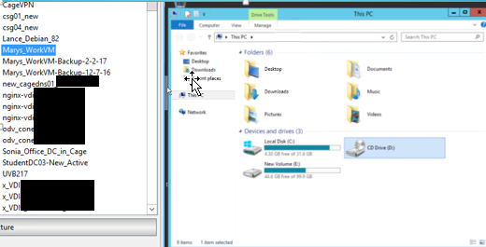
XEN CONSOLE : Window to Xen’s soul

Slide 10
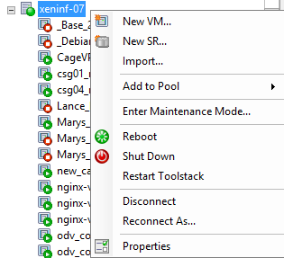
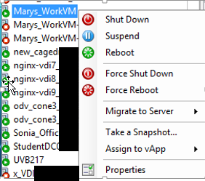
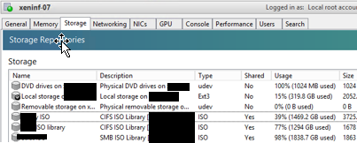
MORE ON XEN CONSOLE

Slide 11
HOTPLUGGING – Walks like a duck
Virtualized hard drive
  Flat file
  Binary
  Must be virtually plugged into a VM
  Looks like your “D:” drive
  Virtually unplugged when done
  Flat file (D: drive) stored on filer

Slide 12
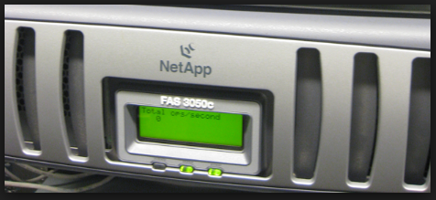
What’S A FILER
External Storage
  Terrabytes of storage
Stores:
  Student’s U:\ drive folders
  Hot plug drives

